Slide 1
Data Mining - INTRODUCTION

Slide 2
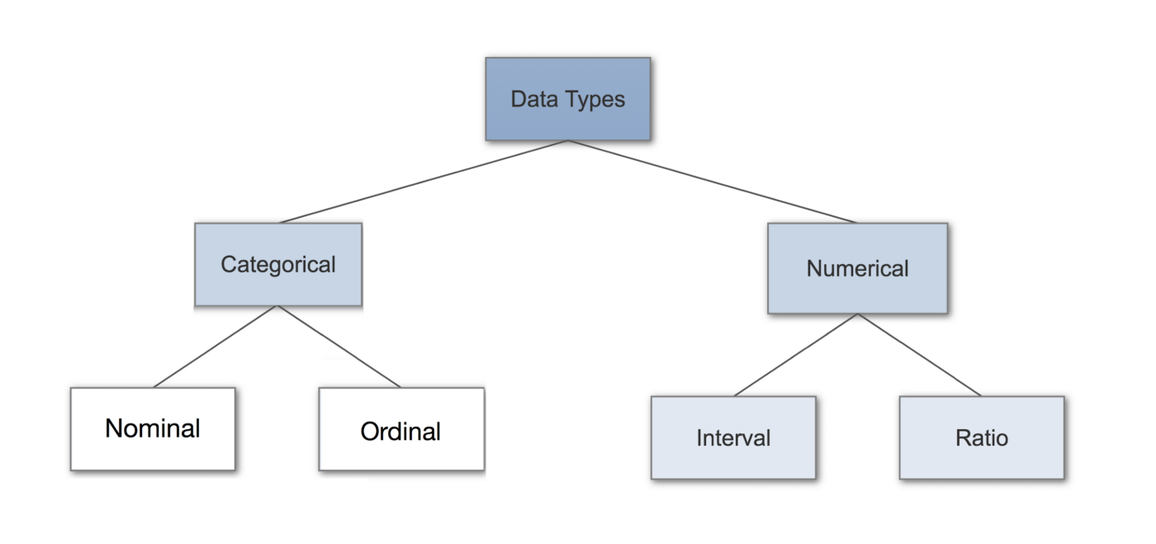
DATA TYPES

Slide 3
TYPES OF DATA
Categorical Data – represents characteristics, labels (not quantitative)
Nominal (any order)
Ordinal (order matters)

Slide 4

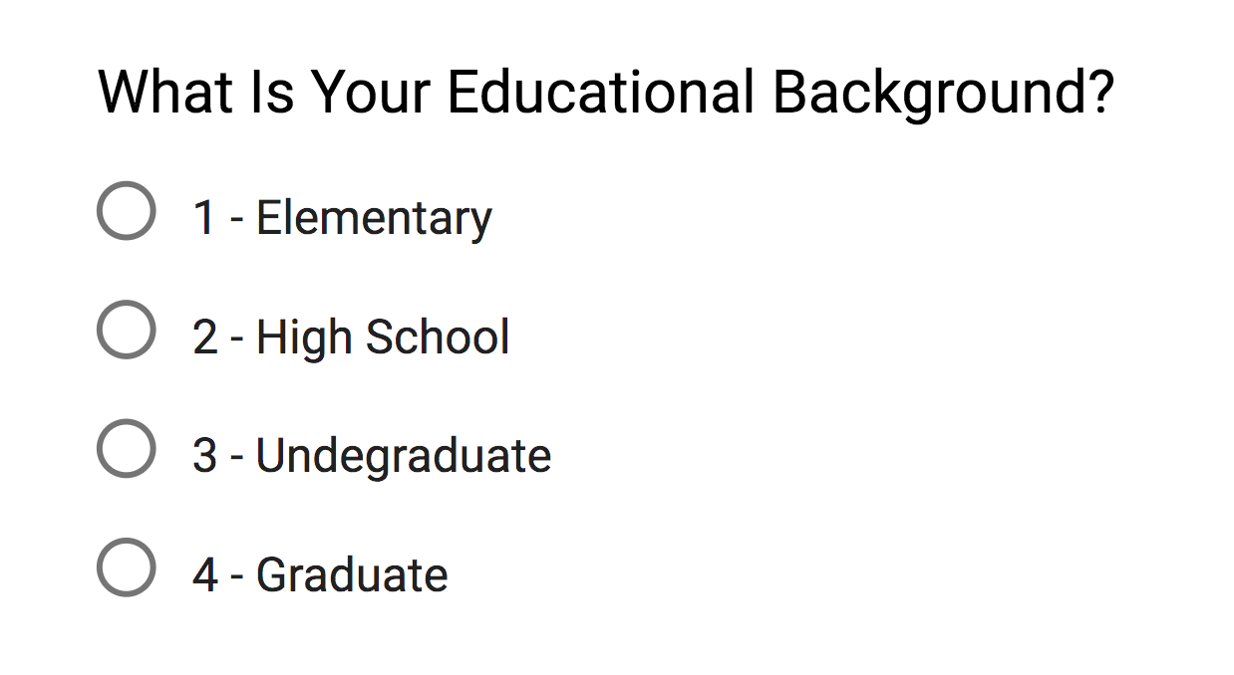
TYPES OF DATA
Categorical Data
Nominal
Ordinal

Slide 5
TYPES OF DATA
Numerical Data
Discrete – count, can’t be measured, eg. number of heads in 100 coin flips
Continuous – measured, can’t be counted,
Interval (no absolute zero)
Ratio (absolute zero)

Slide 6
WHAT DATA REPRESENTS?
More than numbers
It’s a snapshot of the world (like a photograph)
It is possible to recollect lots of information from one photo (same is possible with data)
Pictures are data too.

Slide 7
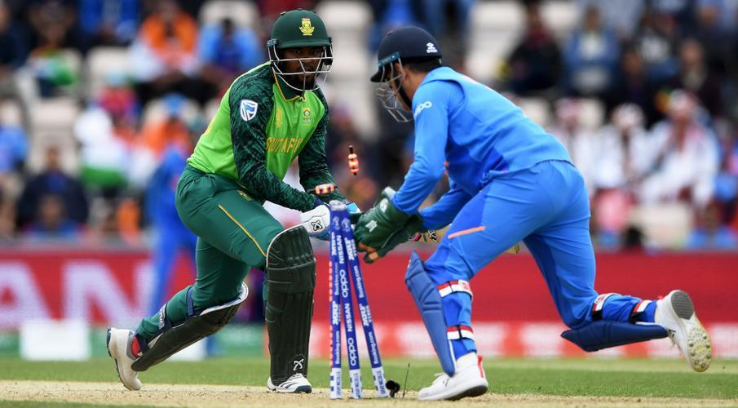
WHAT DATA REPRESENTS?

Slide 8
WHAT DATA REPRESENTS?
A single data point can have a who, what, when, where, and why attached to it
Look at everything around, find context, and see what your dataset looks like as a whole

Slide 9
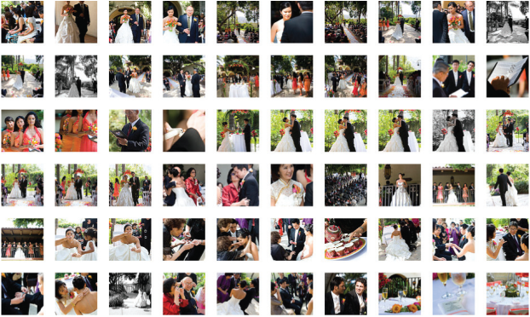
WHAT DATA REPRESENTS?
A photo sequence

Slide 10
WHAT DATA REPRESENTS?
Still though, these are snapshots, and you don’t know what happened in between each photo.
For example, there was about five minutes of confusion during the ceremony when we tried to light a candle but the wind kept blowing it out.
This is where sampling comes in.

Slide 11
WHAT DATA REPRESENTS?
The data is a simplification—an abstraction—of the real world.
Visualization is an abstraction of data !!!
The connection between data and what it represents is the key to visualization

Slide 12
WHAT DATA REPRESENTS?
It is key to
thoughtful data analysis
deeper understanding
Computers can turn numbers into shapes & colors,
but we must make the connection between data and real life,
Make graphics for extract something of value

Slide 13
WHAT DATA REPRESENTS?
Hard to see the connection in BIG data
but it’s more obvious when you look at data for an individual
Travel pattern, Food pattern

Slide 14
WHAT DATA REPRESENTS?
What are their likes and dislikes?
What kind of personality do they have?
Are there major diﬀerences between neighboring cities and towns?

Slide 15
WHAT DATA REPRESENTS?
Just like what it represents, data can be complex with variability and uncertainty,
But consider it all in the right context, and it starts to make sense.

Slide 16

VARIABILITY
It’s a firefly move along the walking path and circle around the trees.
Can you guess where a fireﬂy goes next based on its ﬂight path?
Variability !!!

Slide 17
VARIABILITY
The path is what you care about.
Not the starting point, end point and average position.
With data, you can find patterns, trends, and cycles, but it’s not always a smooth path from point A to point B.
Consider the fluctuations in the data

Slide 18
VARIABILITY
2001 – 2010, there were 363,839 fatal automobile crashes in the United States.
However, is there anything you can learn from the data, other than that you should drive safely?

Slide 19
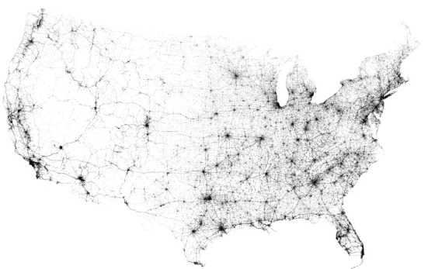
VARIABILITY
higher concentration of accidents in large cities and major highways
Fewer accidents where there are fewer people and roads

Slide 20
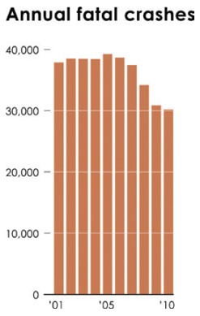
VARIABILITY
Accidents still occurred in the tens of thousands annually,
But, significant decline from 2006 through 2010,

Slide 21
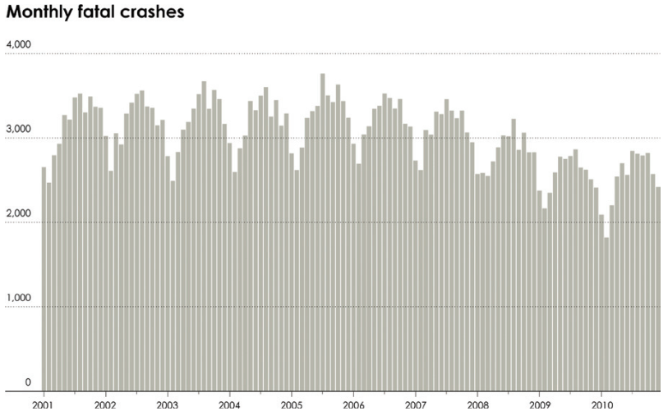
VARIABILITY

Slide 22
VARIABILITY
Incidents peak during the summer months..?
However, there’s variability when you compare specific months over the years.

Slide 23
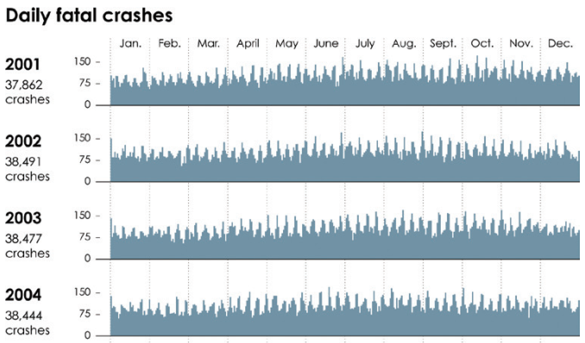
VARIABILITY
Daily crashes reports higher variability

Slide 24
VARIABILITY
it’s hard to make out patterns at this level because of the variability.
Instead of showing values at every hour, day, or month, you can aggregate on specific time segments to explore the distributions

Slide 25
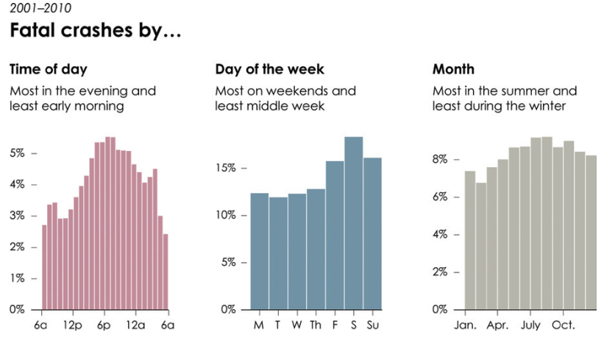
VARIABILITY

Slide 26
UNCERTAINTY
A lot of data is estimated rather than absolute counts
An analyst considers a sample, and make education guess about a full population.
What about the meters / readings in cars?
The estimated battery life on your laptop?
Weigh yourself more than once?
Sugar & Blood Pressure level (samples / mean) – How trustable?

Slide 27
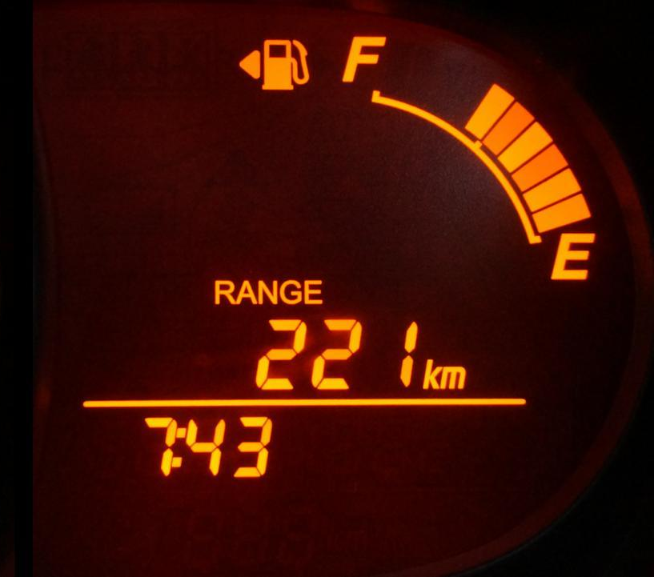
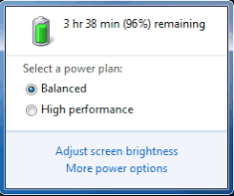

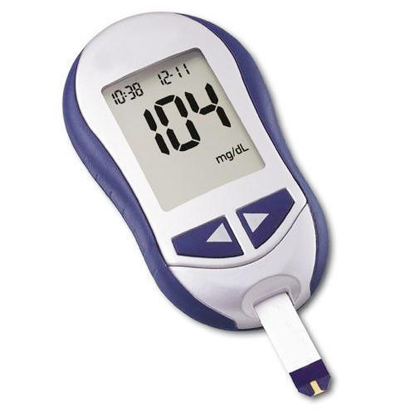
UNCERTAINTY
A lot of data is estimated rather than absolute counts

Slide 28
UNCERTAINTY
We always move with samples
Even a small margin of error can make a big difference

Slide 29
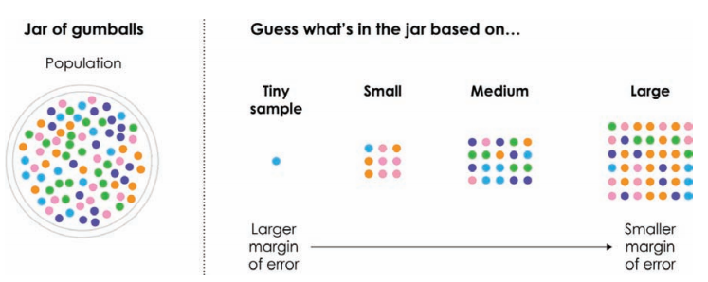
UNCERTAINTY
Imagine you have a jar of gumballs that you can’t see into, and you want to guess how many of each color there are.

Slide 30
CONTEXT
Look up at the night sky, and the stars look like dots on a flat surface.
You perceive stars to be the same distance away from you
If you could fly out beyond the stars, what would the constellations look like?

Slide 31
CONTEXT
Change your perspective on a dataset,
It can help you decide what they represent
And how to interpret them
Without context, data & data visualization is useless

Slide 32
CONTEXT
You have to know
Who – collected, and for whom
How – the data of interest was collected
What – your data is about
When – find the time period of the data
Where – find the spatial information
Why – the reason data was collected

Slide 33
CONTEXT
Context can help you
add a dimension—a layer of information—to your data graphics

Slide 34
CONTEXT
In 2010, Gawker Media,
which runs large blogs like Lifehacker and Gizmodo,
was hacked, and 1.3 million usernames and passwords were leaked.
The passwords were encrypted, but the hackers cracked about 188,000 of them, which exposed more than 91,000 unique passwords.

Slide 35
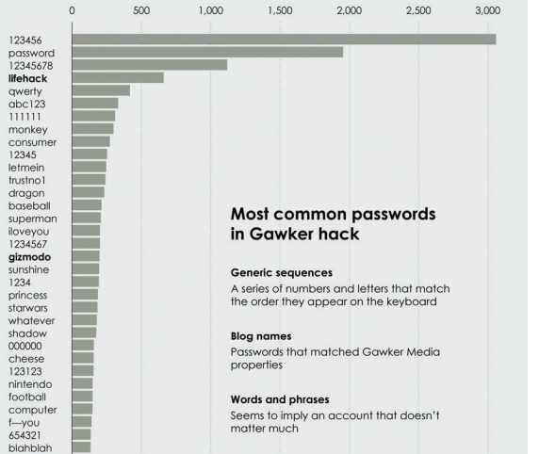
CONTEXT
What would you do with this kind of data?

Slide 36
CONTEXT
Data privacy is more important, so it’s better to limit what you show and look at.
Treat others’ data the way you would want your data treated.

Slide 37
CONTEXT
Data is an abstraction of real life,
but if you gather enough context,
you can at least put forth a solid effort to make sense of it.

Slide 38
Descriptive statistics

Slide 39
Measure of Central Tendency

Slide 40
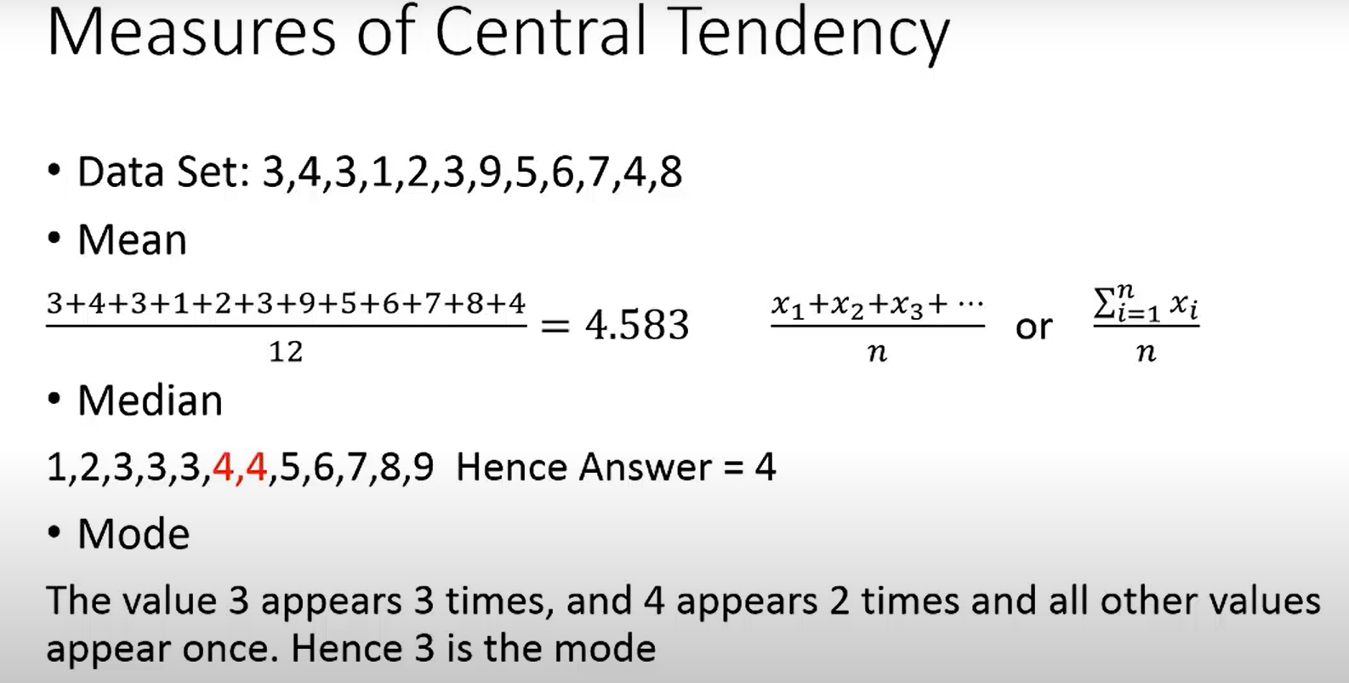

Slide 41
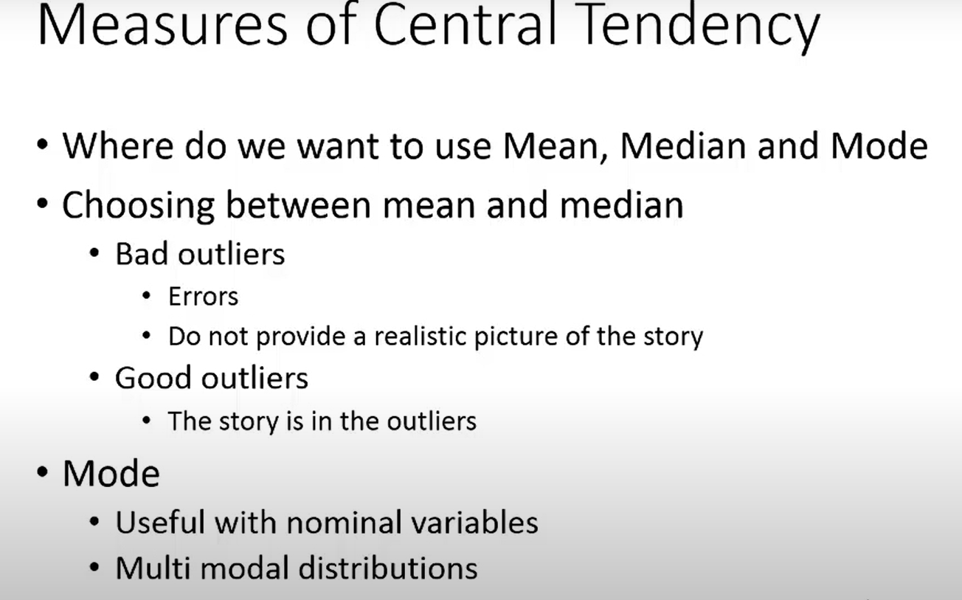

Slide 42
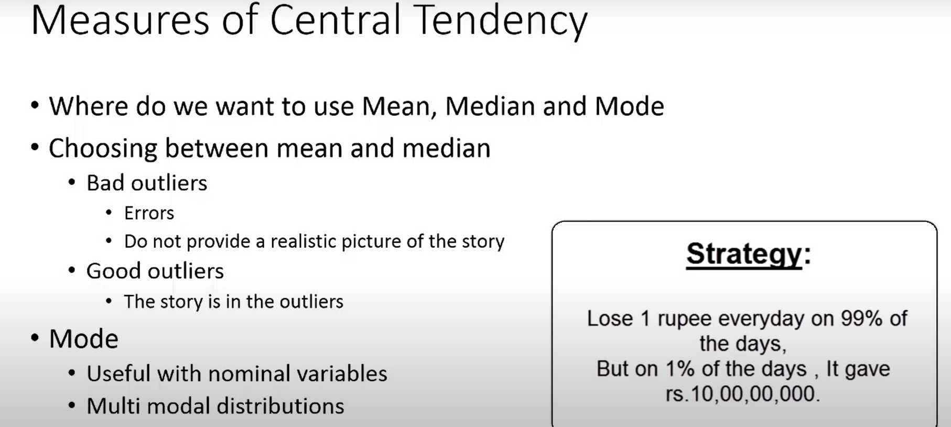

Slide 43
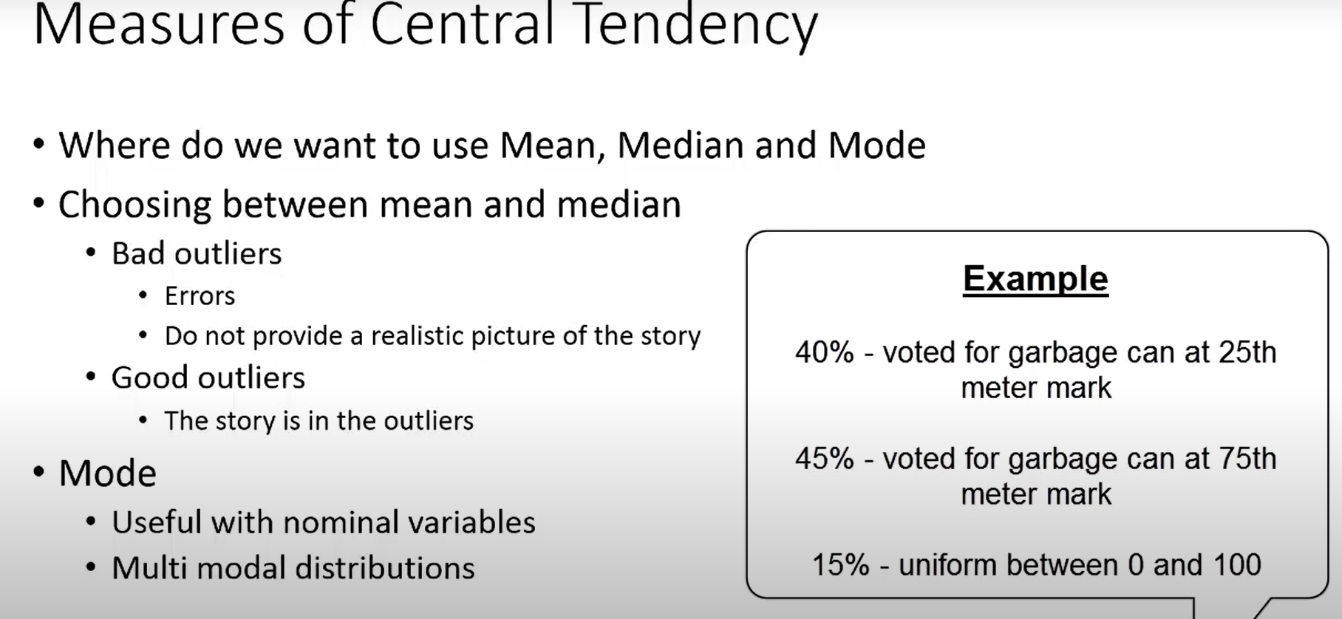

Slide 44
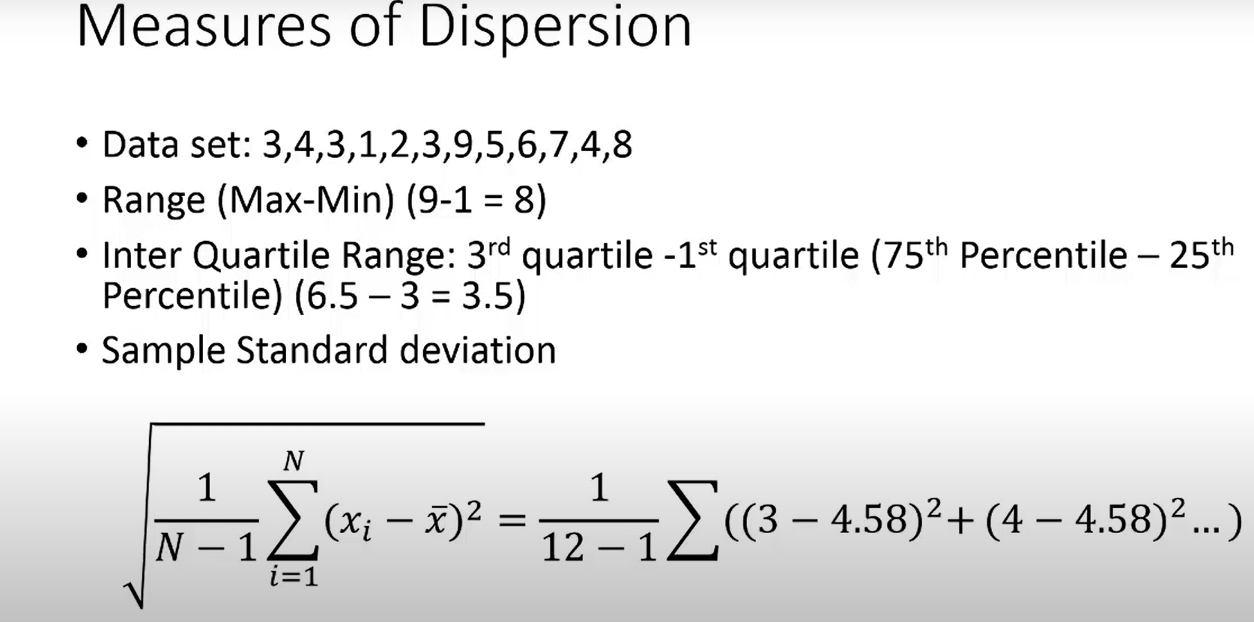

Slide 45
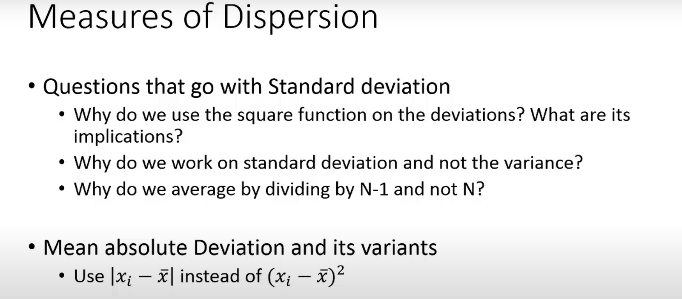

Slide 46
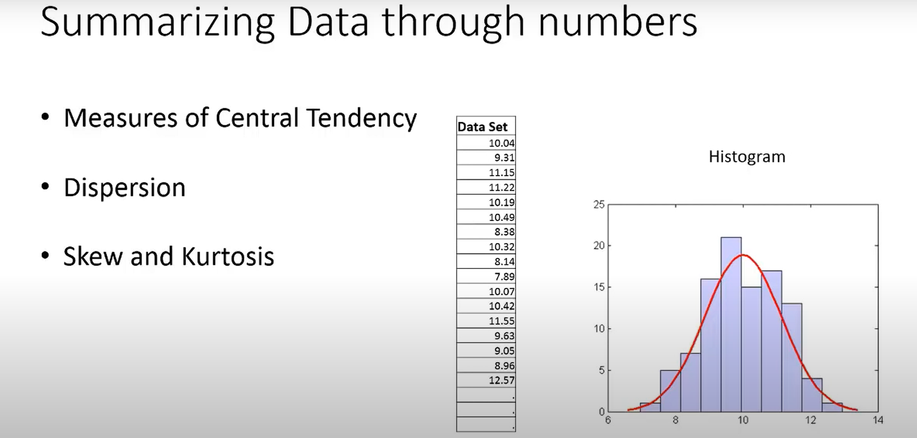

Slide 47
Measure of Dispersion

Slide 48
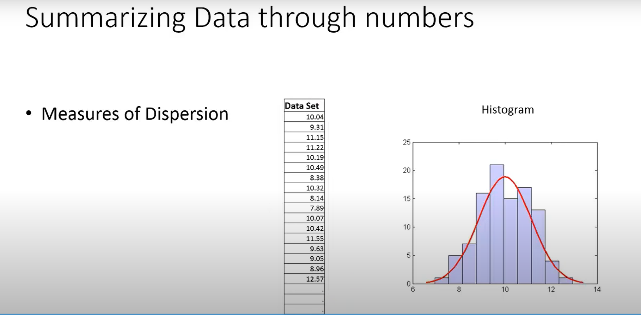

Slide 49
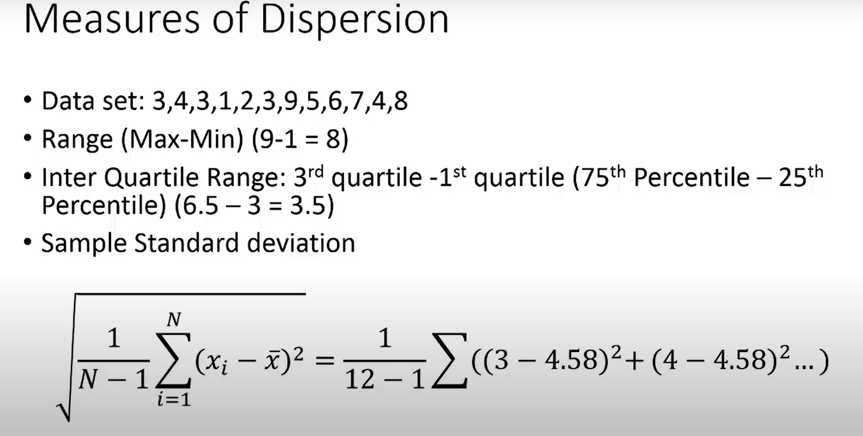

Slide 50
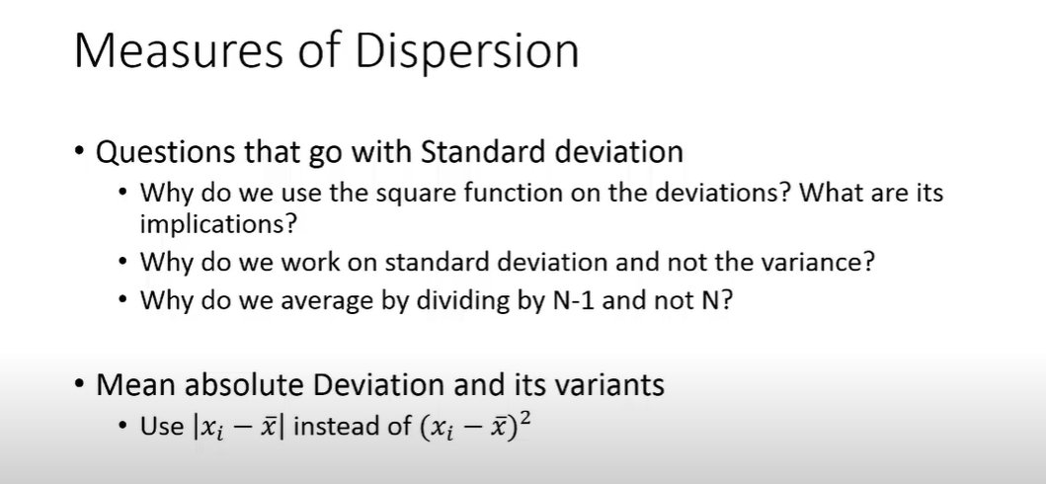

Slide 51
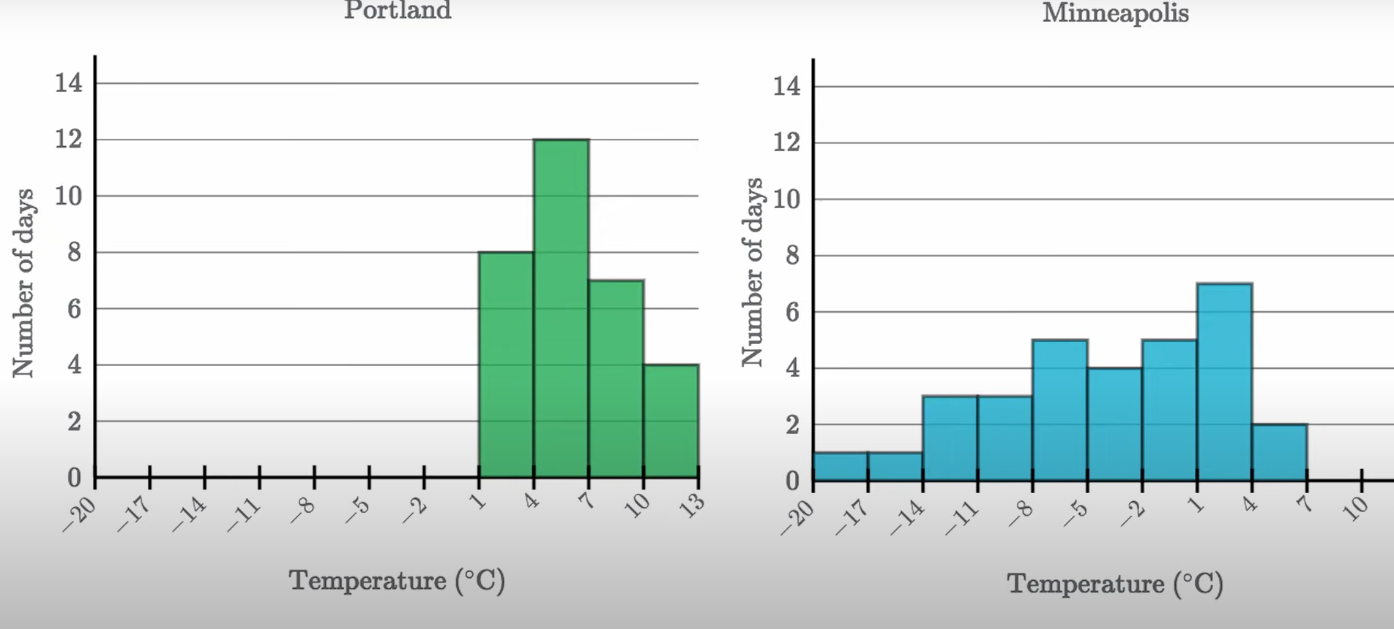

Slide 52
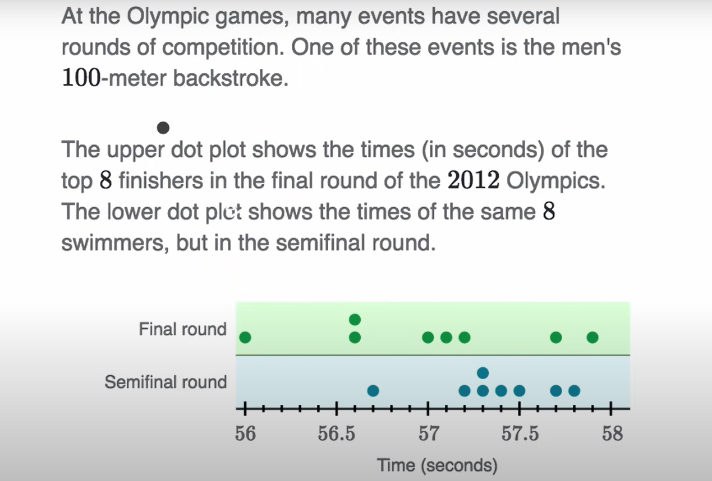

Slide 53
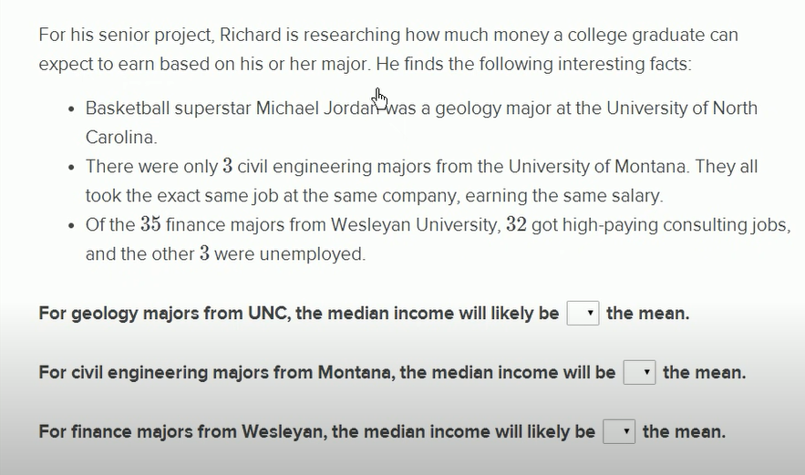

Slide 54
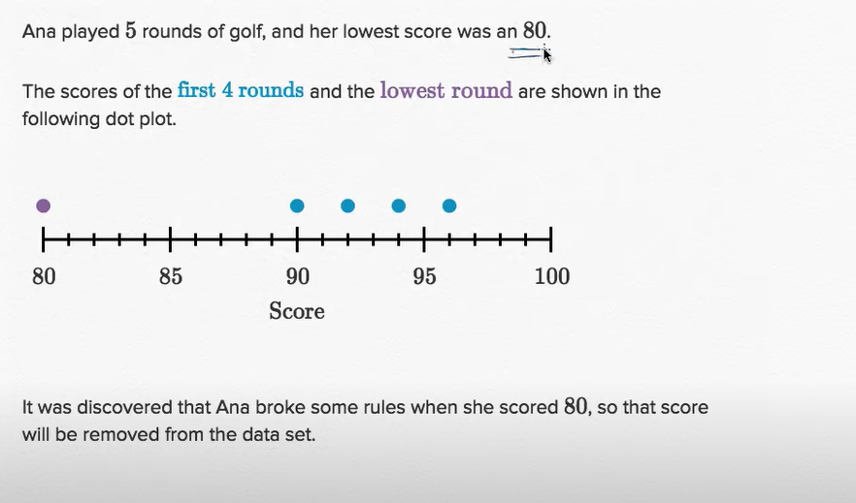
Impact on median & mean: removing an outlier

Slide 55
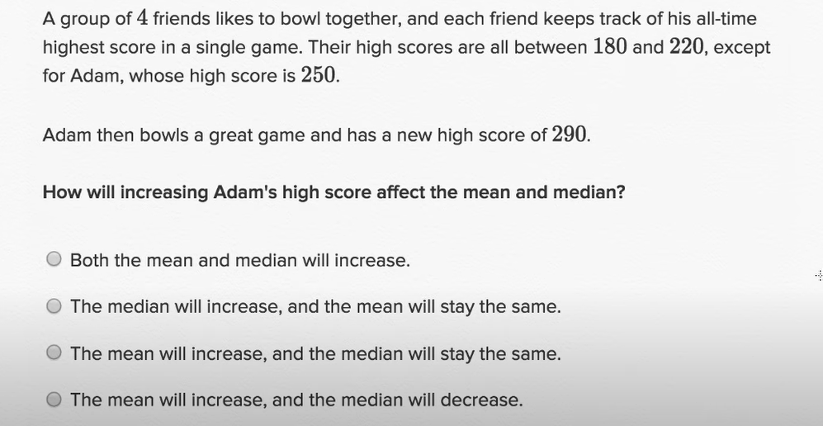

Slide 56
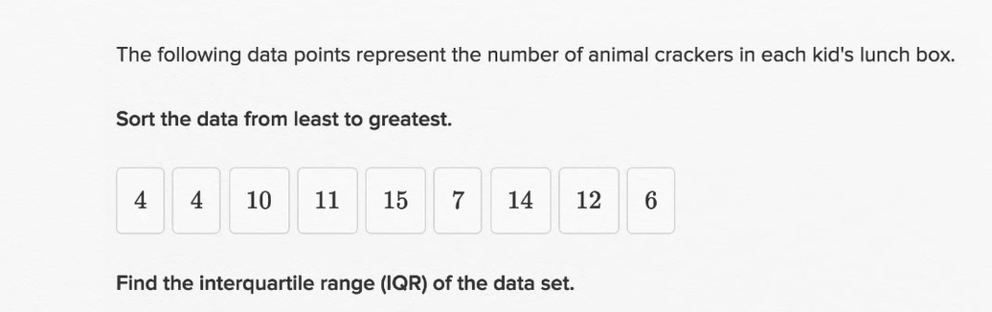
Interquartile range

Slide 57
SUMMARY
Data comes in different shapes and sizes with uncertainty
It twists. It turns. It fluctuates.
It can be personal, and even poetic
“As a result, you can find visualization in many forms”

